Slide 1



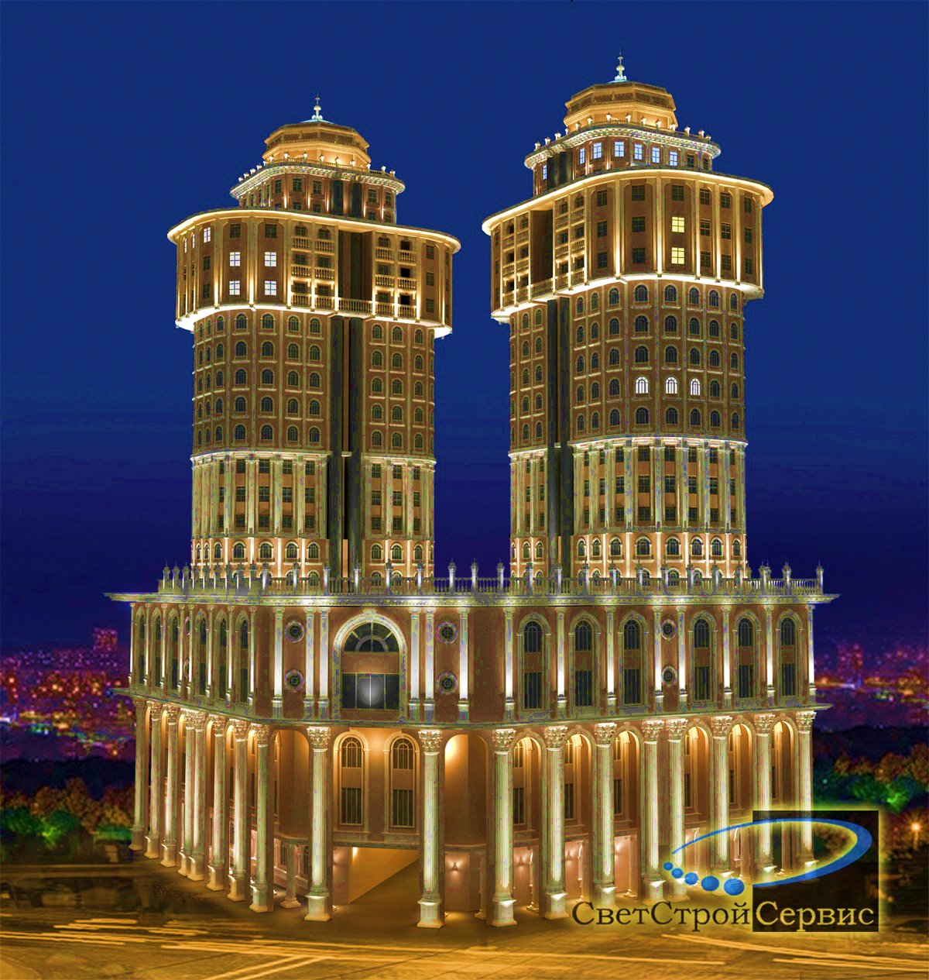
The Monetary Policy Committee of the National Bank of Tajikistan
Topic: The State of Macroeconomic Indicators and Monetary Policy
NBT
Monetary Policy, Research and Development Department
№38 /July 31st, 2024

Slide 2

World Economy and its prospects (IMF, in %)
NBT
+0,1
WORLD
ECONOMY
DEVELOPED
COUNTRIES
DEVELOPING
COUNTRIES
+0,2
3
+0,1
The World Bank projects global economic growth in 2024 to remain at 2.6%, unchanged from the previous year.
The International Monetary Fund (IMF) has forecasted Tajikistan's economic growth at 6.5% for 2024.
2
3

Slide 3
Global Price Increase of Goods and Products (in %, Source: NBT and WB)
NBT
 | FAO Index | Meat Products | Dairy Products | Grains | Oil | Sugar
2023-06 | 123,1 | 119,0 | 119,9 | 126,6 | 115,8 | 152,2
2023-12 | 119,2 | 111,7 | 118,7 | 122,8 | 122,3 | 134,2
2024-03 | 119,0 | 115,0 | 124,0 | 110,9 | 130,6 | 133,4
2024-04 | 119,3 | 116,7 | 123,8 | 111,6 | 130,9 | 126,6
2024-05 | 120,6 | 117,0 | 126,3 | 118,7 | 127,8 | 117,1
2024-06 | 120,6 | 116,9 | 127,8 | 115,2 | 131,8 | 119,4
3

Slide 4
Real sector stance: Annual inflation and its structure (June, 2024)
NBT
INFLATION
3,5
4
Inflation expectations among the population for the current year stand at 3.3%.

Slide 5
GDP Growth by Sectors (January - June, 2024, in %)
NBT
5

Slide 6

Foreign-economic sector: Trade balance (Jan – June, 2024, million)
NBT
6

Slide 7
Balances of Deposits, Loans, and Issued Loans (January - June, 2024)
NBT
Deposits and Loans Balance
(annual growth, in %)
Issued Loans (Jan-June, mln. Somoni)
7

Slide 8
Monetary Sector: Monetary Sterilization Operations (June, 2024)
NBT
Securities and overnight deposits of the NBT
(balance, billion somoni, monthly)
Liquidity level of the banking system
(balance, billion somoni, monthly)
- 0,3
- 0,6
Overnight Deposits
8

Slide 9

NBT's operational mechanism of the interest rate policy
NBT
Interest Rate of Interbank Loans
Refinancing Rate
Overnight Loans Rate
Overnight Deposit Rates
9

Slide 10
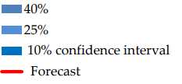

Forecast of the target indicators
NBT
Refinancing Rate %)
Inflation (%)
10

